Slide 1
Instruction Execution and Timing Diagram

Slide 2
Introduction
With the help of timing diagram we can understand the working of each instruction and its execution of a microprocessor.
It is the graphical representation of process in steps with respect to time. The execution time is represented in T-states.
The timing diagram represents the clock cycle and duration, delay, content of address bus and data bus, type of operation ie. Read/write/status signals.

Slide 3
Important terms related to timing diagrams
T-state
Instruction cycle (IC)
Machine cycle (MC)

Slide 4
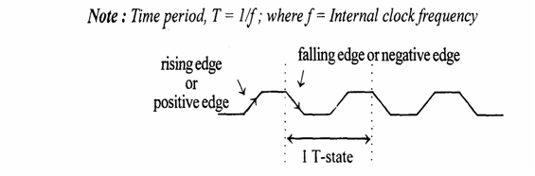
T-state
A portion of an operation carried out in one system clock period is called as T-state

Slide 5
Instruction cycle
It is defined as the number of steps required by the CPU to complete the entire process ie. Fetch and execution of one instruction.
The fetch and execute cycles are carried out in synchronization with the clock.

Slide 6
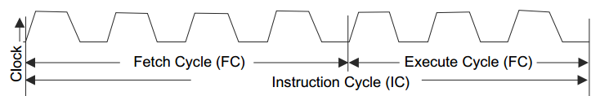

Slide 7
The time period of Fetch Cycle (FC) is a fixed but the time required to execute an instruction or time period of Execute Cycle (EC) is variable
The total time required to execute an instruction is IC = FC + EC

Slide 8
Machine cycle
It is the time required by the microprocessor to complete the operation of accessing the memory devices or I/O devices.
In machine cycle, various operations like opcode fetch, memory read, memory write, I/O read, I/O write are performed.

Slide 9
8085 machine cycles
The 8085 microprocessor has 5 basic machine cycles.
Opcode fetch cycle (4T)
Memory read cycle (3 T)
Memory write cycle (3 T)
I/O read cycle (3 T)
I/O write cycle (3 T)

Slide 10
Opcode fetch cycle

Slide 11
Fetch Operation
Each instruction of the processor has one byte opcode.
The opcodes are stored in memory.
The processor executes the opcode fetch machine cycle to fetch the opcode from memory.
In the beginning of the fetch cycle, the content of the program counter is sent to the memory(requires 1 clock cycle)

Slide 12
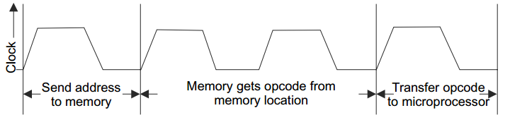
Fetch cycle

Slide 13
The memory first reads the opcode (requires 1 clock cycle).
Then the memory sends the opcode to the microprocessor

Slide 14
The time taken by the processor to execute the opcode fetch cycle is 4T states.
The first 3 T-states are used for fetching the opcode from memory
The remaining T-states is used for internal operations by the processor.

Slide 15
Example of opcode fetch cycle of instruction ADI 05H
Assume that the accumulator contains the result of previous operation 03H and instruction is held at memory locations 2030H and 2031H.

Slide 16
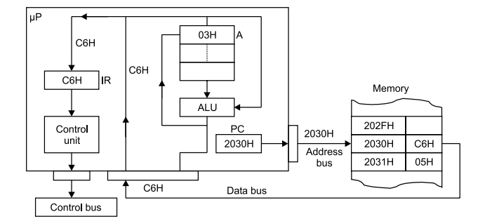
fetch operation: reads 1st byte (Opcode, C6H) in instruction register (IR)

Slide 17
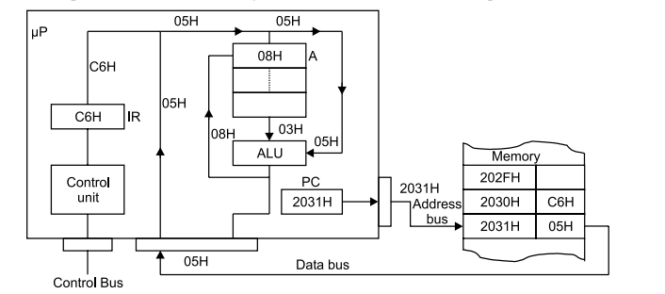
Instruction execute : reads 2nd byte from memory and adds to accumulator

Slide 18
Opcode Fetch in Timing Diagram
The purpose of an opcode fetch cycle is to read the contents of a memory location containing the opcode addressed by the program counter and to place it in the instruction register.

Slide 19
Opcode Fetch in Timing Diagram
The following steps occur during Opcode Fetch Cycle.
The Program counter (PC) places the 16 bit memory address on the address bus.
At T1 high order address is placed at A8-A15 and lower order address is placed at AD0- AD7 and the ALE signal goes high, IO/M goes low, and both s0 and s1 goes high; which identifies the op-code fetch cycle.
The control unit sends the control signal RD to enable the memory chip and remains active till two clock periods.

Slide 20
Now the op-code from memory location is placed on the multiplexed data bus. The transition of RD indicates the end of this step.
The op-code byte is now placed on instruction decoder and the execute cycle is carried out.

Slide 21
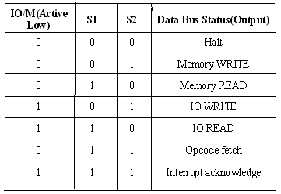
Control Signals

Slide 22
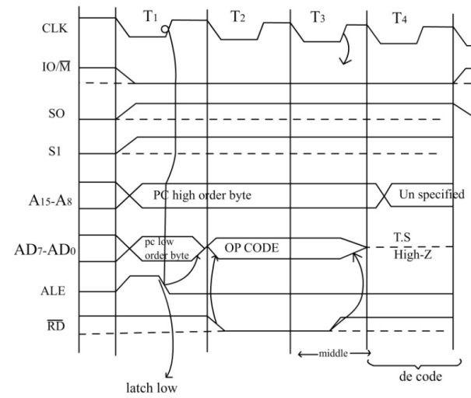
Timing diagram of opcode fetch

Slide 23
During the first clock: State T₁
8085 puts a low on signal IO/M, indicating a memory operation and set S₁=1, Sₒ=1 indicating an opcode fetch operation.
PCL AD7-AD0 PCH A8-A15
ALE high indicates to latch this lower order address

Slide 24
During the second clock: State T2
RD signal goes low, indicating read operation and the opcode to be fetched is placed on the data bus ADₒ-AD₇
(PC) (PC)+1

Slide 25
During the third clock: State T₃
The opcode available in the data bus ADₒ-AD₇ is read by the processor and moved to the instruction register
RD signal goes high, indicating deactivated.

Slide 26
During the fourth clock: State T₄
8085 decodes the instruction and determines whether to enter state T₅ or to enter T₁ state of the next m/c cycle from the operation code.
Based on the opcode of the instruction, further operations such as fetching operands, writing in to memory, etc. take place.

Slide 27
Example
Fetch a byte 41H stored at memory location 2105H. For fetching a byte, the microprocessor must find out the memory location where it is stored.
Then provide condition (control) for data flow from memory to the microprocessor.

Slide 28
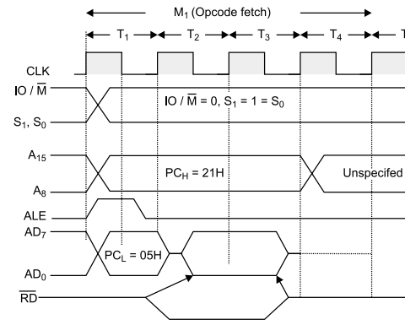

Slide 29
The µP fetches opcode of the instruction from the memory as per the sequence
A low IO/ M means microprocessor wants to communicate with memory.
The µP sends a high on status signal S1 and S0 indicating fetch operation.
The µP sends 16-bit address. AD bus has address in 1st clock of the 1st machine cycle,T1.
AD7 to AD0 address is latched in the external latch when ALE = 1.
AD bus now can carry data.

Slide 30
In T2, the RD control signal becomes low to enable the memory for read operation.
The memory places opcode on the AD bus
The data is placed in the data register (DR) and then it is transferred to IR.

Slide 31
During T3 the RD signal becomes high and memory is disabled. • During T4 the opcode is sent for decoding and decoded in T4. • The execution is also completed in T4 if the instruction is single byte.

Slide 32
Memory Read Cycle

Slide 33
Memory read machine cycle
Memory read machine cycle is executed by the processor to read a data byte from memory after opcode fetch operation.
The instructions which have more than one byte word size will use the machine cycle after the opcode fetch machine cycle.
Similar to opcode fetch cycle, except
It has only 3 T states
The S₀ signal is set to 0

Slide 34
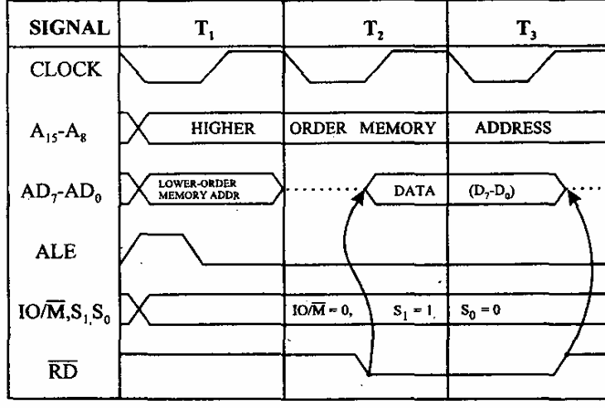

Slide 35
State T₁
The IO/M signal made low to indicate that a memory reference is required.
S₀=0, S₁=1 indicating that memory READ operation is to be performed.
Contents of high byte of the memory address register, (PCH or H) on A8-A15 lines and the contents of the low byte of the memory address register (PCL or L) on ADₒ-AD₇

Slide 36
ALE to HIGH, indicating the beginning of the second machine cycle

Slide 37
State T₂
ALE goes to low, the 8085 latches the low byte of the address lines, since the same lines as going to be used as data lines
RD signal goes LOW indicating a READ operation.
If the address sent during state T₁ is from PC, then PC is incremented by 1, otherwise not.
The external logic gets the data from the memory location addressed by the memory address register such as (H,L) pair and places the data on to data bus ADₒ-AD₇

Slide 38
State T₃
RD signal goes to high indicating transfer the data from the data bus to internal register such as the accumulator.

Slide 39

Example
This instruction requires 2-machine cycles (M1 and M2).
M1 requires 4-states and M2 requires 3-states, total of 7-states

Slide 40
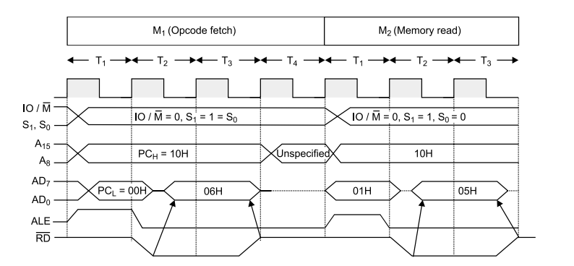
Timing diagram for MVI B,05H

Slide 41
In T1-state, the high order address {10H} is placed on the bus A15 ⇔ A8 and low-order address {00H} on the bus AD7 ⇔ AD0 and ALE = 1
In T2 -state, the RD line goes low, and the data 06H from memory location 1000H are placed on the data bus.
The fetch cycle becomes complete in T3-state.
The instruction is decoded in the T4-state. During T4-state, the contents of the bus are unknown.

Slide 42
With the change in the status signal, IO/ M = 0, S1 = 1 and S0 = 0, the 2nd machine cycle is identified as the memory read.
The address is 1001H and the data byte 05H is fetched via the data bus
Clock frequency of 8085 = 3.125 MHz Time ( T ) for one clock = 1/3.125 MHz = 0.32 µS Time for Memory Read = 3T = 3*0.320 µS = 0.96 µS Total Execution time for Instruction = 7T = 7*0.320 µS = 2.24 µS

Slide 43
Memory Write Machine Cycle

Slide 44
Memory Write Cycle
The memory write machine cycle is executed by the processor to write a data byte in a memory location.
The processor takes, 3T states to execute this machine cycle

Slide 45
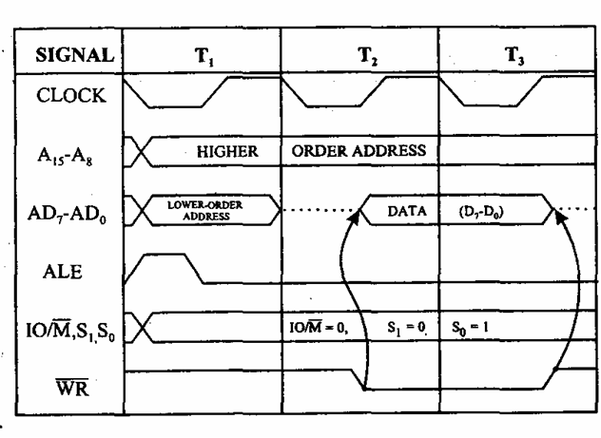
Memory write timing diagram

Slide 46
During T1 state 8085 places the memory address register high byte, such as the contents of the H register on lines A8-A15
Also places the MAR low byte such as the contents of the L register on lines AD0-AD7
ALE to HIGH, indicating the beginning of MWRMC.

Slide 47
At state T2, ALE goes to low, the 8085 latches the low byte of the address lines since the same lines are going to be used as data lines.
WR signal goes low indicating memory write operation. It also places the contents of the internal register say accumulator on data lines AD7-AD0.

Slide 48
Example STA 526AH
STA 526AH stores the accumulator content (C7 H) in memory location 526AH
It requires 4 machine cycles and 13 T states
Address Mnemonics Opcode
41FF STA 526AH 32
4200 6A
4201 52

Slide 49
It’s a 3 byte instruction.
During the first machine cycle, the PC content (41FF) is stored in the address bus and opcode 32H is fetched and decoded by processor
During 2nd machine cycle, the low order memory address (6AH) is fetched by the processor
During third machine cycle, the high order memory address (52H) is loaded in the processor
During fourth machine cycle, the address 526AH is placed on the address bus and the accumulator content (C7) is written in that address.

Slide 50
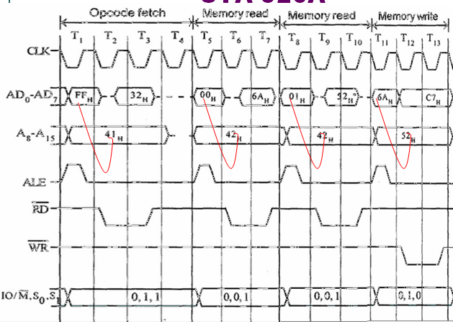

Slide 51
I/O Read Machine Cycle

Slide 52
I/O Read Cycle
The I/O Read cycle is executed by the processor to read a data byte from I/O port or from the peripheral.
The processor takes 3T states to execute this machine cycle.
8085 uses 8 bit port address. So the port address is placed in low order as well as high order address bus.

Slide 53
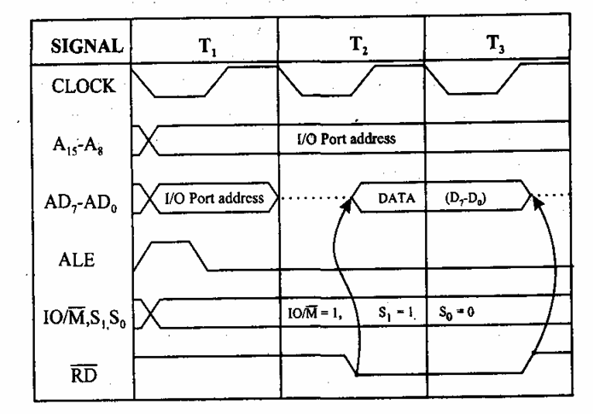
Timing diagram of I/O Read cycle

Slide 54
Example: IN C0H
This instruction inputs data from the port indicated by 8 bit address to the accumulator
It requires 3 machine cycles and 10 T states
Address Mnemonics Opcode
4125 IN C0H DB
4126 C0

Slide 55
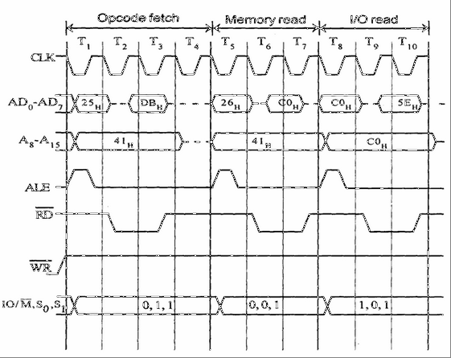
Timing Diagram

Slide 56
I/O Write Cycle

Slide 57
I/O Write Cycle
The I/O write machine cycle is executed by the processor to write a data byte in the I/O port or to a peripheral
The processor takes, 3T states to execute this machine cycle.

Slide 58
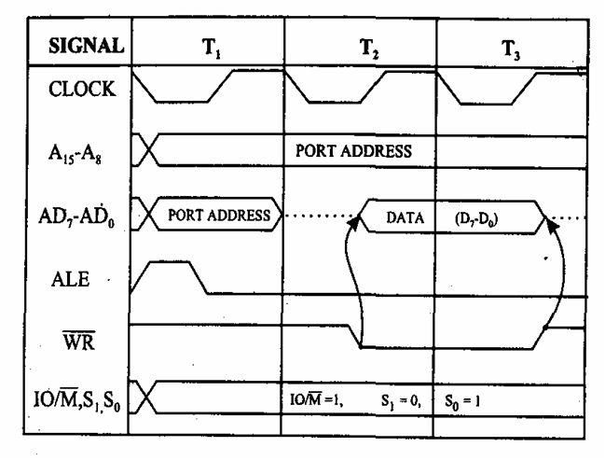
Timing Diagram

Slide 59
Example: OUT 01H
This instruction outputs data from the Accumulator to a port specified by 8 bit address
It requires 3 machine cycles and 10 T states
Address Mnemonics Opcode
2050 OUT 01H D3
2051 01

Slide 60
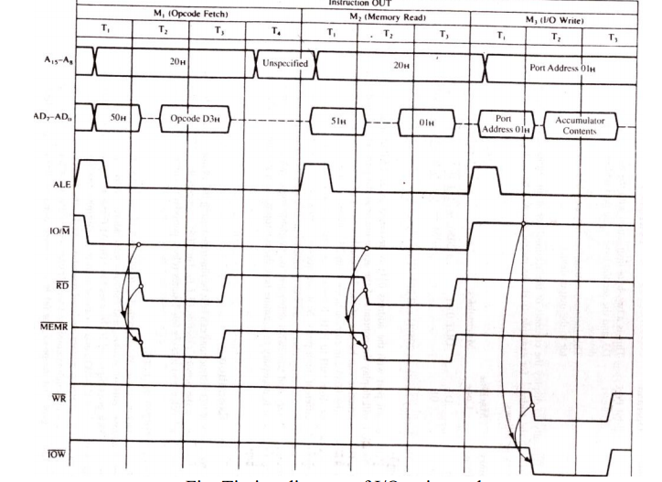

Slide 61
Other Instructions..
INR M
This instruction increments the memory location pointed to by the HL register by 1
It requires 3 machine cycles and 10 T states
Address Mnemonics Opcode
4105 INR M 34

Slide 62
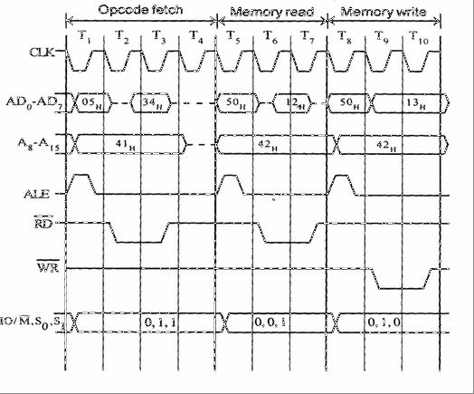

Slide 63
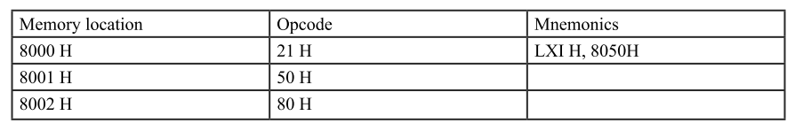
Draw and explain the timing diagram for the instruction LXI H, 8050H.

